Slide 1
Auckland Streetlight Network & Retrofit
David Dick

Slide 2
Points for today
Auckland Transport (AT) Streetlight Background
Retrofit programme- accelerated renewal road lighting – LED conversion
LED luminaires
Tele-Management system

Slide 3
Background
105,000 road lights (NZ=350,000)
45,000 P category
60,000 V category

Slide 4
Current Stock
HID luminaires 99,000
LED Luminaires 4,900
Incandescent lamps 700
Fluorescent 400
Amenity lights 2,500

Slide 5
Contract areas
 | Total lights | Stage 1 retrofit lights
North | 23,200 | 4,520
West | 14,100 | 4,780
Central | 33,600 | 16,100
South | 33,700 | 19,300
HGI | 400 | 300
Total | 105,000 | 45,000

Slide 6
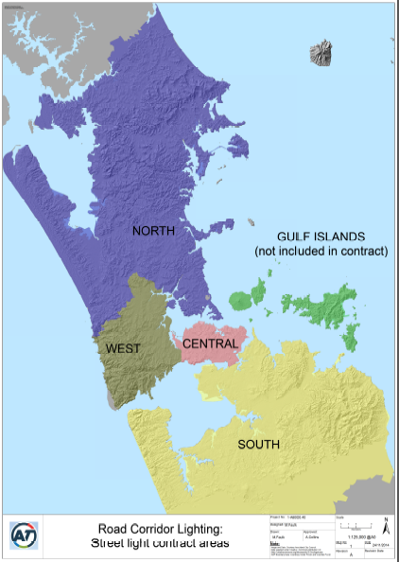
Five maintenance & renewals contracts across the region

Slide 7
Retrofit Programme
Stage 1 – P category
Stage 2 – V category
[$22m – over 5 years
45,000 lights
60,000 lights
45,000 lights]

Slide 8
To complete Stage 1 end June 2018
V category Stage 2 still needs Board sign off
June 2015 – 3,500 3,500
June 2016 – 9,000 12,500
June 2017 – 16,000 28,500
June 2018 – 16,500 45,000

Slide 9
Two men crew – target 25 lights/day
Currently 3 crews – best day is 80/day
Next year 2016-17 – 16,000 – 1,400/month

Slide 10
LED Luminaires
AT – operates an approval process
Working with Christchurch City Council and NZTA
        M30
        Christchurch – Approved list
        AT – Approved list

Slide 11
Approved list – Luminaires
Subject to commercial arrangements
No guarantee we will use the luminaires
Suitability of luminaire for the road configuration
About to go to tender for a further 16,000 luminaires

Slide 12
Five non price attributes for P category retrofit
Marking Criteria and Score Calculation
Maximum Luminous Intensity (Candella) |  |  | Gamma80 Luminous Intensity (Candella) |  |  | P3 Design Spacing (m) achieved |  |  | P4 Design Spacing (m) achieved |  |  | Luminaire Power (W)
20.0% |  |  | 20.0% |  |  | 8.0% |  |  | 8.0% |  |  | 14.0%
LI Max | Score % |  | Gamma80 | Score % |  | P3 | Score % |  | P4 | Score % |  | Watts | Score %
> 2000 | FAIL |  | > 500 | FAIL |  | < 48 | FAIL |  | < 63 | FAIL |  | > 28 | FAIL
2000 | 10 |  | 500 | 10 |  | 48 | 35 |  | 63 | 35 |  | 28 | 35
1889 | 20 |  | 418 | 20 |  | 49 | 40 |  | 64 | 40 |  | 27 | 40
1785 | 30 |  | 350 | 30 |  | 50 | 50 |  | 65 | 50 |  | 26 | 45
1686 | 40 |  | 292 | 40 |  | 51 | 60 |  | 66 | 60 |  | 25 | 50
1593 | 50 |  | 245 | 50 |  | 52 | 70 |  | 67 | 70 |  | 24 | 55
1506 | 60 |  | 205 | 60 |  | 53 | 80 |  | 68 | 80 |  | 23 | 60
1422 | 70 |  | 171 | 70 |  | 54 | 90 |  | 69 | 90 |  | 22 | 65
1344 | 80 |  | 143 | 80 |  | ≥ 55 | 100 |  | ≥ 70 | 100 |  | 21 | 70
1270 | 90 |  | 120 | 90 |  |  |  |  |  |  |  | 20 | 80
≤ 1200 | 100 |  | ≤ 100 | 100 |  |  |  |  |  |  |  | 19 | 90
 |  |  |  |  |  |  |  |  |  |  |  | ≤ 18 | 100

Slide 13
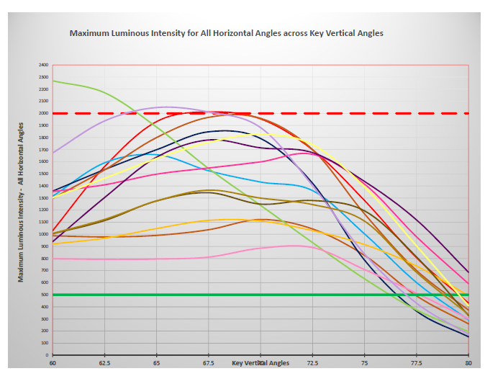

Slide 14
Tele – Management
Trim light output to control energy (ramp up dimming)
Measure energy use
Better information when negotiating electricity contract
Report problems
Interactive management

Slide 15
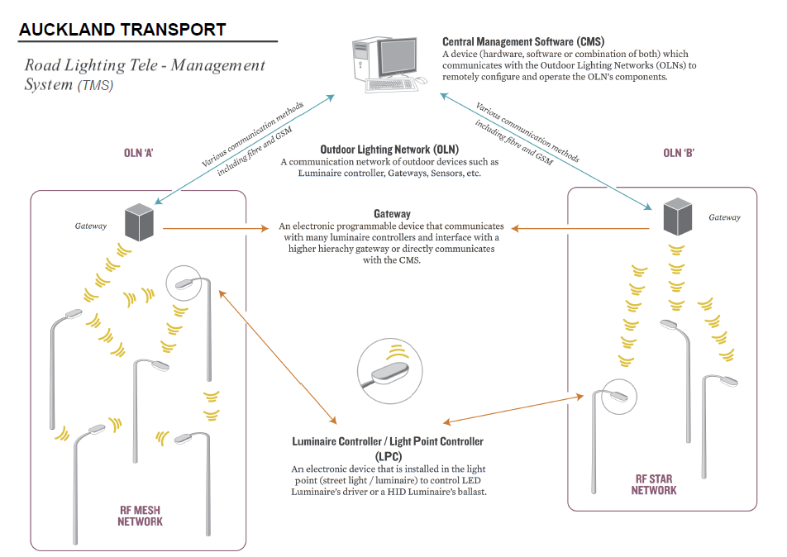
Tele Management Overview

Slide 16
Tele – Management
Write a specification for what you want
Keep flexibility for the future
AT has a 5 year contract with SLV
CMS must be able to communicate with many Outdoor Lighting Networks (OLN)

Slide 17
Tele – Management
Communication between gateway and LPC
Power line carrier
RF
  Point to point
  RF mesh
  Dedicated network
  Shared network

Slide 18
Summary
Stage 1 energy savings $2.16M/year
Additional savings tele management $.33M/year
Call centre savings reduced calls. (currently 750/month)
New energy contract? Better information.

Slide 19
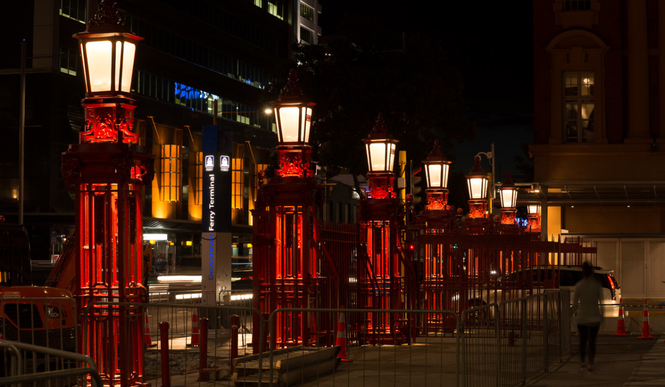
“The future is an opportunity and an obligation”

